Slide 1


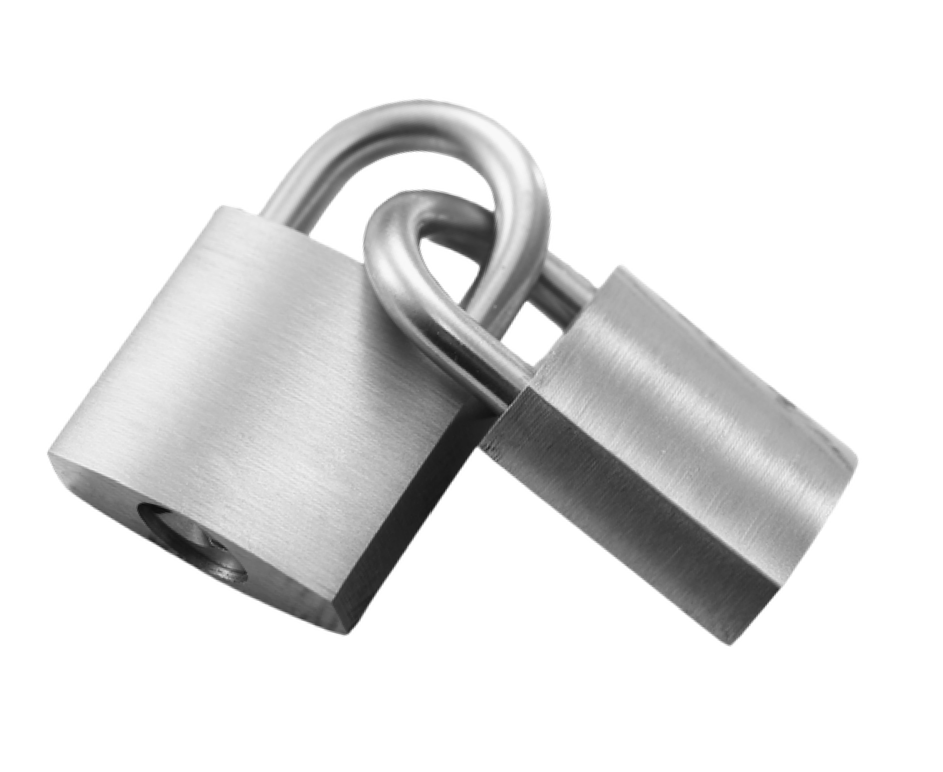

Netaji Subhas
Institute of Technology
Presented By : Anjali Kumar
Suhani Srivastav
Manu Priya

Slide 2

Core Security Foundations
Cyber security focuses on protecting confidentiality, integrity, and availability of information through coordinated policies, advanced technologies, and responsible human behavior. It integrates risk assessment, preventive controls, threat monitoring, and structured incident response strategies to ensure digital systems remain resilient, secure, and reliable despite the rapid evolution of global cyber threats and technological complexity.

Slide 3

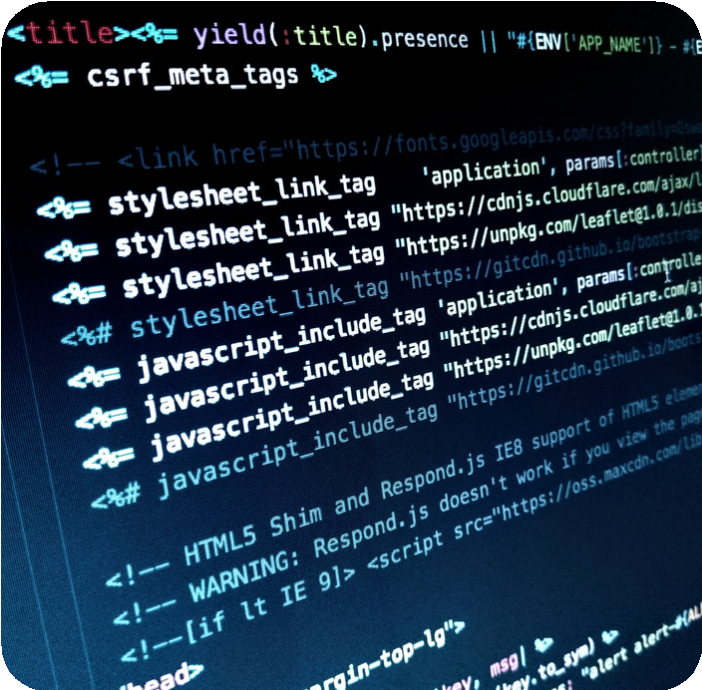





Phishing Attacks Deceptive messages trick users into revealing passwords and confidential financial information.
Malware Threats
Malicious software designed to damage systems and steal sensitive user information.
Ransomware Incidents
Attackers encrypt victim data and demand payment to restore system access.

Slide 4


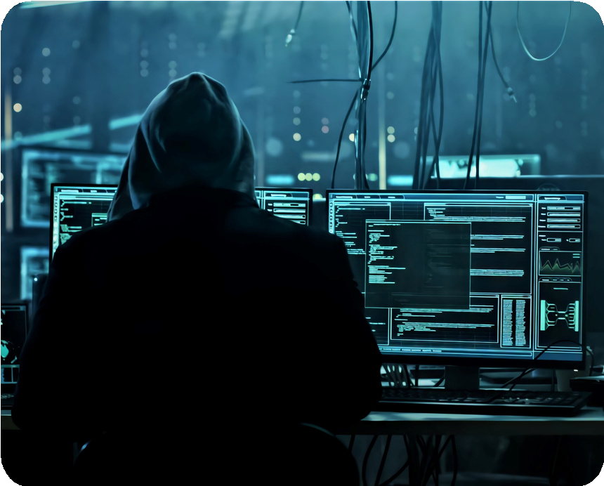

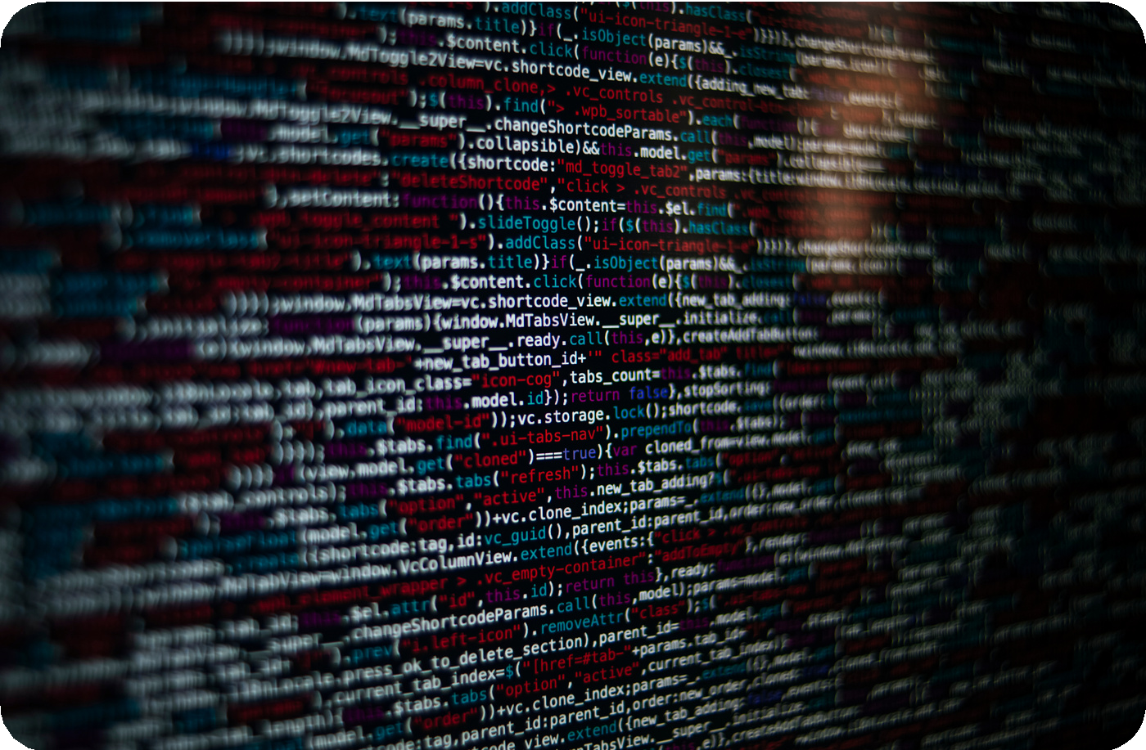


Email Phishing
Fraudulent emails impersonate trusted institutions to steal login credentials and personal information.
Spear Phishing
Targeted attacks use personalized details to convincingly deceive specific high value individuals.
Smishing Schemes
Text message scams redirect victims toward malicious links requesting confidential personal information.
Vishing Attempts
Voice based deception persuades victims to disclose sensitive banking or account information.

Slide 5


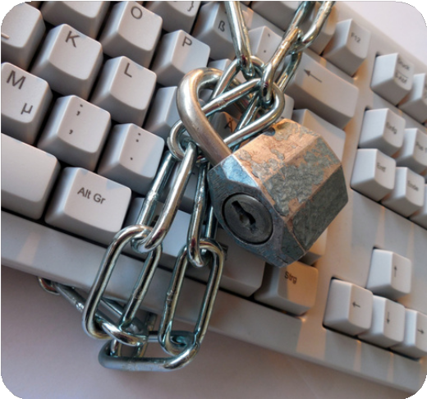
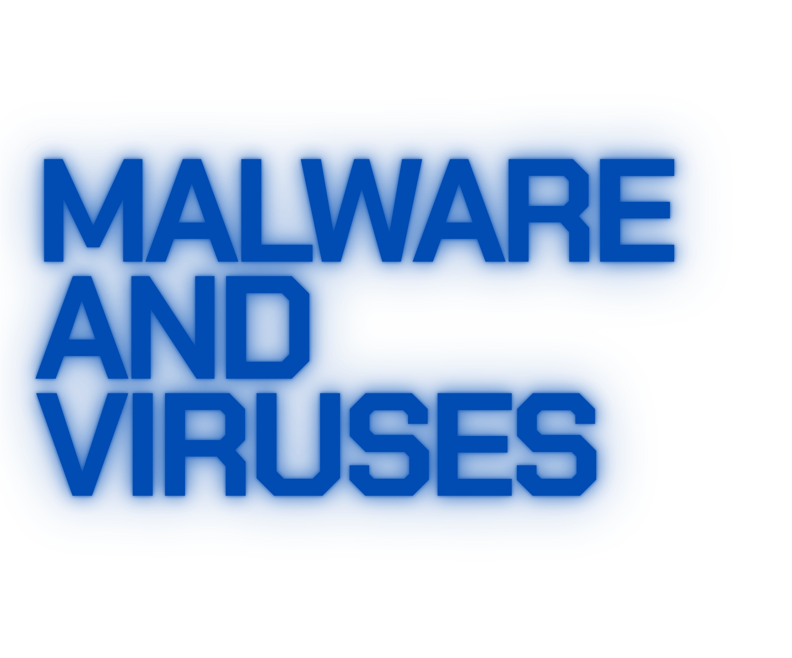
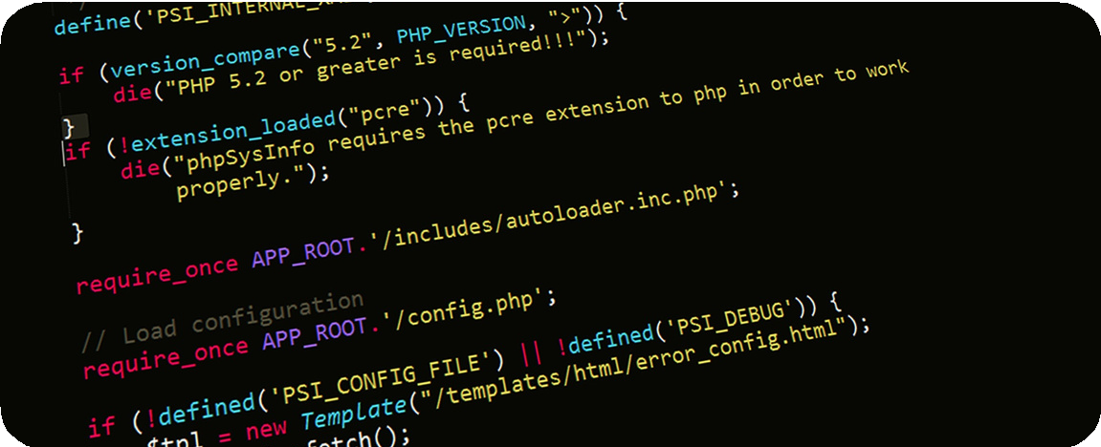


Hidden Digital Dangers
Malware includes harmful software such as viruses, worms, trojans, and spyware that infiltrate systems silently and compromise sensitive information. These threats often exploit weak passwords, outdated software, and unpatched vulnerabilities to spread quickly across networks without immediate detection by users or administrators.
Once activated, malware can corrupt files, monitor user behavior, steal confidential data, and provide unauthorized remote access to attackers. Strong endpoint protection, regular updates, continuous monitoring, and user awareness programs are essential to reduce exposure and prevent severe operational disruptions caused by malicious code.

Slide 6



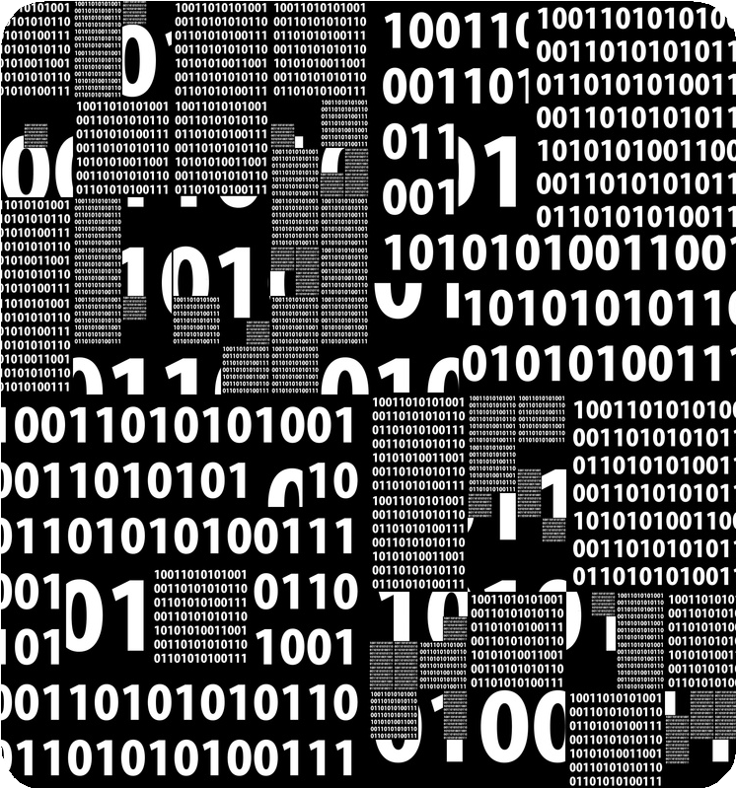
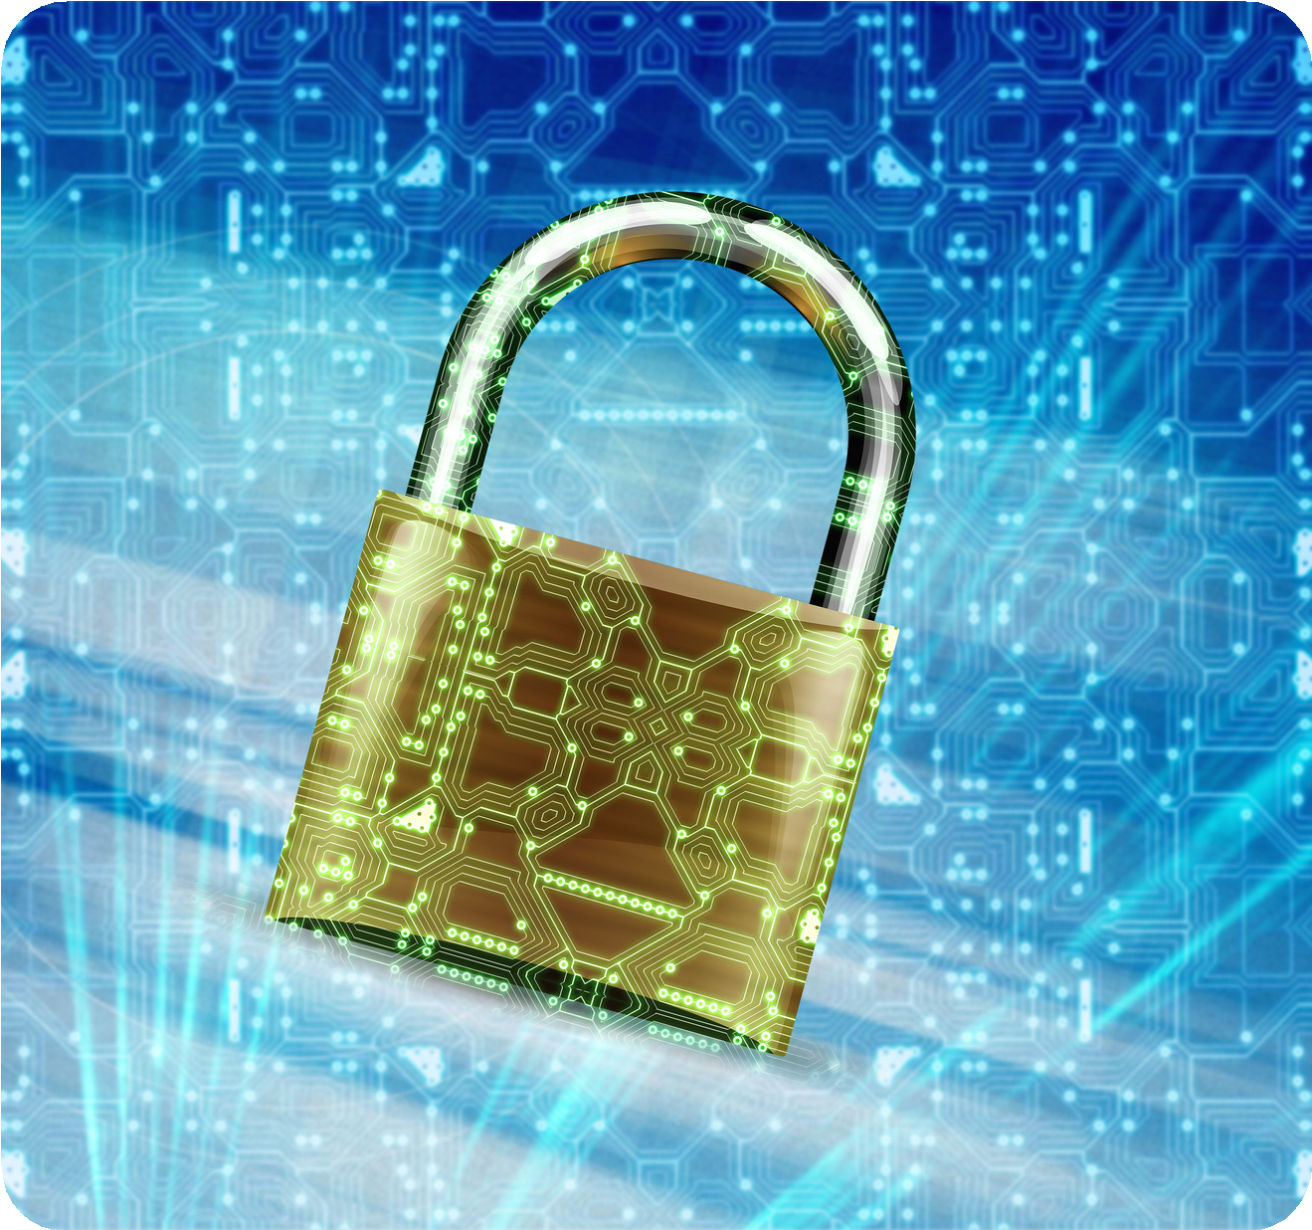

Firewall Protection
Encryption Protocols
Encryption protects transmitted data by converting information into secure coded formats.
Firewalls filter network traffic to block unauthorized external access attempts.

Slide 7

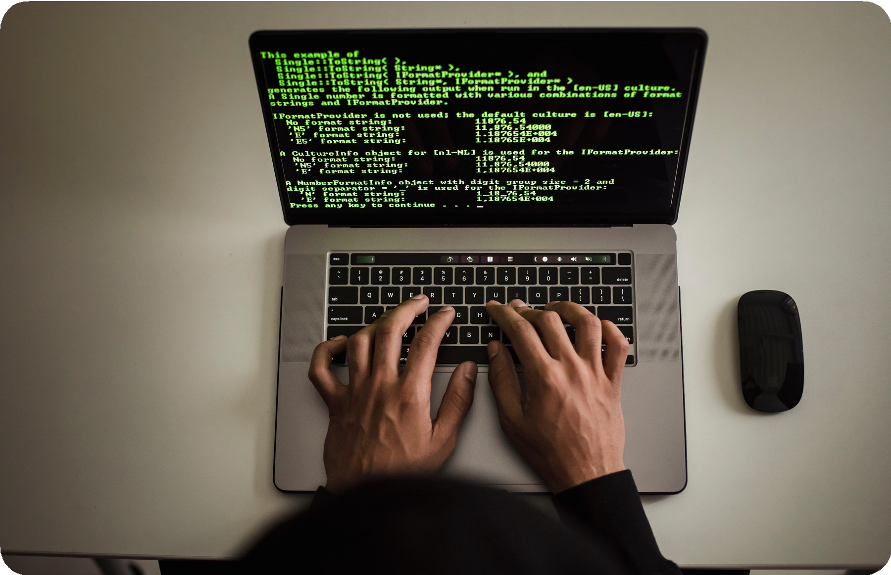



Strong Passwords
Complex passwords significantly reduce risks of unauthorized account access.
Multi Factor
Additional verification
Authentication layers strengthen
protection against credential compromise.
Regular Updates
Timely updates patch vulnerabilities before attackers exploit weaknesses.

Slide 8

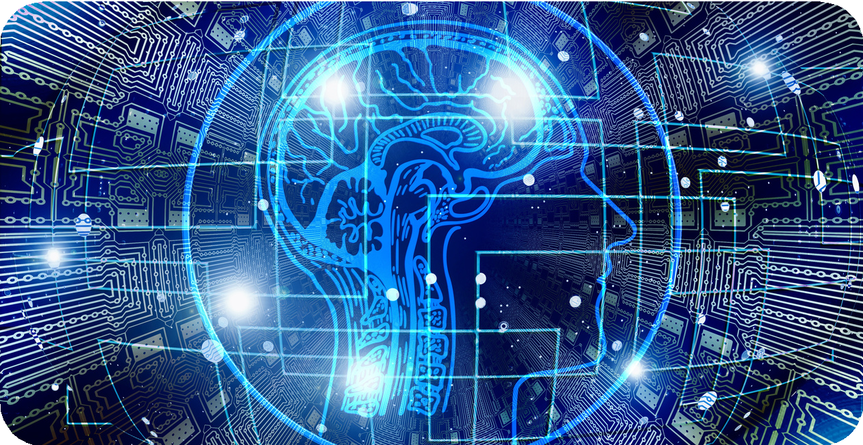


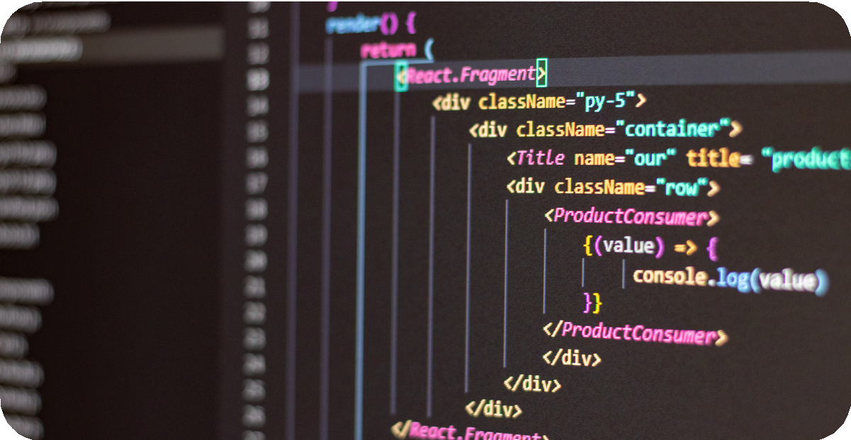
Artificial Intelligence
Artificial intelligence enhances threat detection through behavioral analysis and advanced pattern recognition.
Zero Trust Architecture
Zero trust models require strict verification for every system access request.

Slide 9


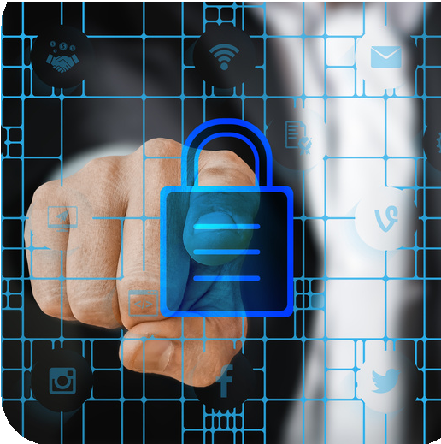
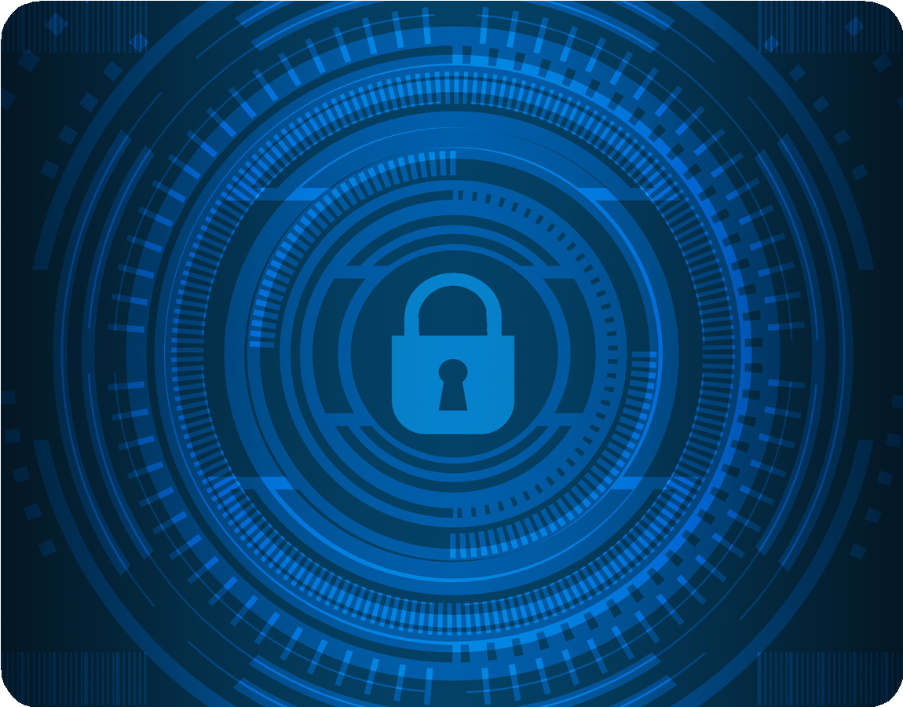


Cyber security is not a one time solution but a continuous commitment to protecting digital environments from evolving threats. By combining advanced technology, strong governance, and informed human awareness, organizations can build resilient systems that withstand disruption. Sustainable digital growth depends on proactive defense strategies, collaboration, and consistent security practices across every operational level.

Slide 10


